Slide 1

System Performance
Computer System Engineering, Fall 2019. (IPADS, SJTU)
Design for performance
Yubin Xia

Slide 2
Improve Performance? Buy New Hardware!
However:
Not all aspects improve at the same pace
Moore's Law is plateauing
Hardware improvements do not always keep pace with load increases
Conclusion
Need to design for performance, potentially re-design as load increases

Slide 3
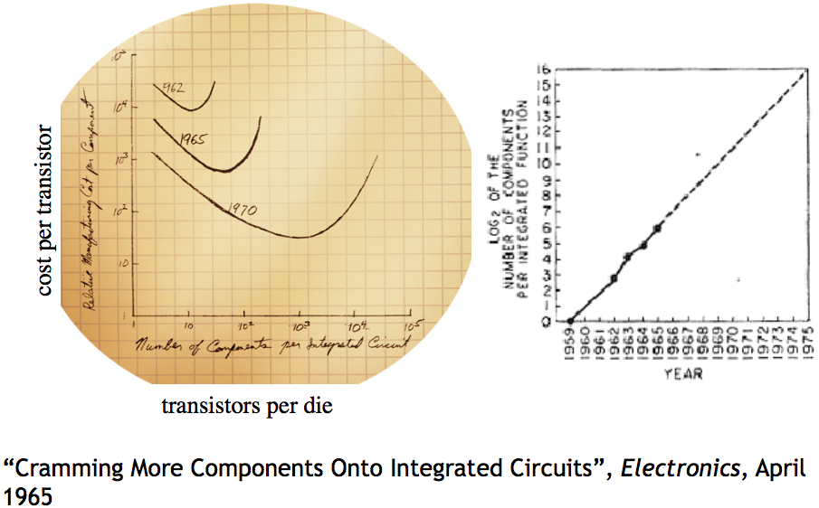
Moore's Law

Slide 4
How to Improve Performance
Step-1. measure the system, and compare it to our system model, to ﬁnd the bottleneck
Step-2. relax the bottleneck

Slide 5
Improving Performance at 3 Layers
Get faster hardware
Fix application: better algorithm, fewer features (not in CSE)
General system optimization techniques:
Batching
Caching
Concurrency
Parallelism (scheduling)
Application
System
Hardware

Slide 6
Performance Metrics

Slide 7
Performance Metrics
Computer Systems can be viewed as interconnected modules
★ Capacity
★ Latency
★ Throughput
★ Utilization

Slide 8
Performance Metrics: Capacity
Capacity – Size or amount of a service
Blocks on storage or memory devices
Cycles on a processor
Requests per second for a web server
Bits per second on a network link
...

Slide 9
Performance Metrics: Latency
Request
Latency: the time it takes from start to finish
Webserver – Time from request to response
Network – Time from send() until receive() done
Procedure – Time from call until return
For a multi-step process (Steps A + B)
Latency_{A+B} ≥ LatencyA + Latency_{B}
Service
Stage-1
Stage-1
…
Stage-n
Response

Slide 10
Performance Metrics: Throughput
Throughput: rate at which work is done
Webserver – Requests per second
Network – Bytes per second
Procedure – Calls per second
Pipeline of modules
Thoughput_{A+B} ≤ minimum(Throughput_{A}, Throughput_{B})
Bottleneck
1000
100
10
Compare measured throughput to possible throughput: utilization

Slide 11
Performance Metrics: Utilization
Utilization – Fraction of capacity used by a workload
CPU is 50% busy, rest in idle loop
75% of disk blocks are allocated
Webserver is running at 20% of capacity
20% of the time network is busy
...
Utilization means bottleneck obvious? Sometimes.
Yes: e.g., CPU is 100% utilized vs. disk is 20% utilized
No: e.g., CPU and disk are 50% utilized, and at alternating times

Slide 12
Relationship between Latency & Throughput
When processing is serial:
Throughput = 1 / (Latency)
When processing is parallel:
Throughput has no direct relationship with latency
How to improve throughput? Reduce latency & Increase paralleling

Slide 13
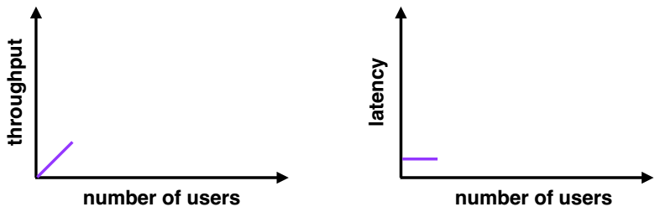
Throughput and Latency
Few users
Low latency
Low throughput (few users = few requests)

Slide 14
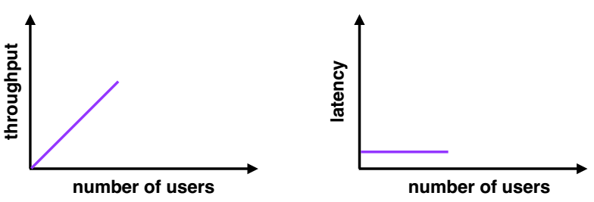
Throughput and Latency
Moderate users
Low latency (new users consume previously idle resources)
High throughput (more users = more requests)

Slide 15
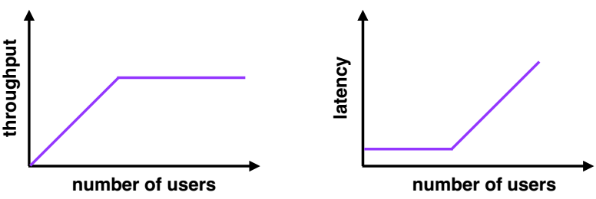
Throughput and Latency
Many users
High latency (requests queue up)
Throughput plateaus (cannot serve requests any faster)

Slide 16
Improving Bottlenecks
Throughput frequently is a resource limit
Example: Buy a fatter pipe but it costs more
Famous saying: You can buy throughput but you can't bribe god
Latency is the harder of the problems
Frequently fundamental limits
Speed of CPU
Speed of communication link (e.g., light)

Slide 17
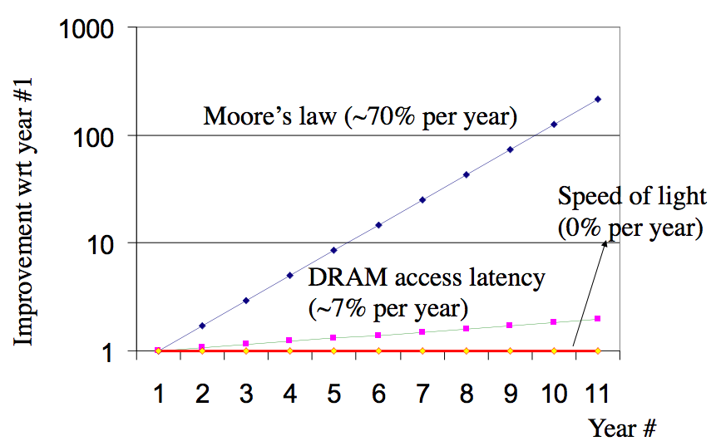
Latency Improves Slowly

Slide 18
Fast Path for Latency Optimizations
Request
Use knowledge of the workload
Make the common cases faster
E.g., cache hit VS. cache miss
if (WorksOnFastPath(request)) DoFastCase(request);
else DoNormalCase(request);
Stage-1
Slow path
Fast path
Stage-2
Stage
…
Stage-n
Response

Slide 19
Fast Path for Latency Optimizations
AverageLatency = Frequencyfast x Latencyfast + Frequencyslow x Latencyslow
Is introducing a fast path worth the effort?
depends on the difference of latency,
and the frequency using fast path,
which is dependent on the workload
Many workloads do not have a uniform distribution of requests,
thus introducing a fast path works well

Slide 20
Caching: Classic Fast Path Optimization
Use knowledge of workload: memory abstractions
Keep common requests in a fast local memory
Check the local memory every access
CPU cache – Cache 1ns, Memory 100ns, 90% hit rate
AverageLatency = 0.9 x 1ns + 0.1 x 100ns = 10.9 ns (100ns -> 10.9ns)
Used everywhere there are memory abstractions
Processors, file systems, TLBs, browsers, DNS, etc.

Slide 21
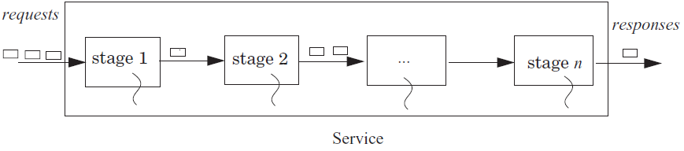
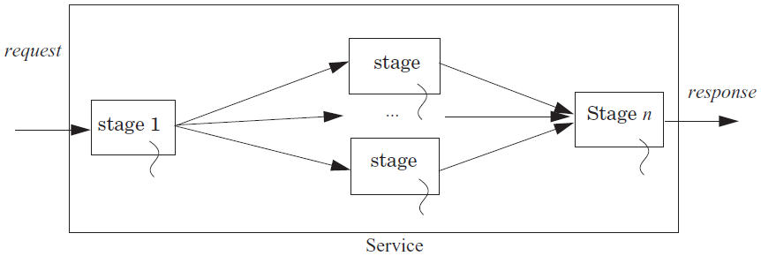
Using Concurrency to Improve Throughput

Slide 22

Reducing Latency using Concurrency
Example: search engine
Splits the index of the Web up in n pieces, each piece on a machine
Frontend sends copies of requests and combines the response
If subtasks are independent to each other
Can use n threads to get a speedup of n
Hard to get the ideal speedup
10 months a man -> 1 month 10 men?
Index Node
Frontend
Index Node
Index Node

Slide 23
Hide Latency by Overlapping
Fetch (5 time units) and process (5 units) 2 blocks (20 units)
Fetch B1; Process B1; Fetch B2; Process B2;
Fetch 2 blocks asynchronously (15 units)
Send request for B1,B2;
Receive B1; Process B1; Receive B2; Process B2
Processors prefetching memory requests
File systems prefetching files
Browser prefetching pages
Fetch B1,B2
Process B1
Process B2
Fetch B1
Process B1
Fetch B2
Process B2
Fetch B2

Slide 24
Queuing and Overload
Overload: whenever the offered load is greater than the capacity of a service for some duration
E.g., 7 threads on 3 processors, must wait in queue (RUNNABLE)
The queuing theory
Unit is the average service time
The waiting time in a queue: 1/(1-ρ), ρ is the utilization
Once the utilization approaches 1, the delay will grow without bound

Slide 25
Queuing and Overload
One solution
Make the capacity match the offered load of requests
Example:
CPU: one instruction per ns; memory: respond takes 10 ns
CPU must make a memory request 10 ns in advance
Memory must serve 10 requests concurrently
If half instructions are memory request, then only 5 concurrently
But cannot predicate the pattern of memory access

Slide 26
Queuing and Overload
If overload appears short period of time
A queue handles short bursts of too much demand by time-averaging with adjacent periods when there is excess capacity
If overload persists over long periods of time
Increase the capacity of the system
Shed load: reduce or limit the offered load

Slide 27
Queuing and Overload
Offered load: the rate of arrival of requests for service
Using bounded buffer to control offered load
Self managing, if the a source needs the results of the output
If source makes no request at all, then offered load decreases
If source holds the request and resubmits it later, offered load doesn't decrease
Put a quota on the source (e.g., max threads per application)
Reducing the offered load when a stage becomes overloaded: e.g., swapping

Slide 28
Fighting Bottlenecks

Slide 29
Why Performance Bottleneck?
1. Physical limitation
Speed of light
The capacity of memory
…
2. Sharing
Several users share a device
Several clients share a server

Slide 30
How to Improve Performance?
1. Measure the system to find the bottleneck
2. Relax the bottleneck
Batch requests
Cache data
Exploit concurrency
Exploit parallelism (by scheduling)

Slide 31
Batching
Frequently it is possible to group requests for more efficiency
Amortize overheads of processing
Schedule requests for better performance
Examples: N messages vs. one message with N requests Disks:
Always transfer a bunch of bytes (sector or block)
Schedule the disk motions

Slide 32
Dallying
Procrastination sometimes helps
Temp files – deleted before written to disk
Examples:
Caches – Write back policy: write absorption
Database transactions – group commit
Might hold your ATM request until others arrive to do batching

Slide 33
Speculation
Guessing at an operation and performing it ahead a time
Need to be able to undo changes if wrong
Examples:
Processors guess at branches, memory access
File systems guess at next file block needed (prefetching)
Easier if space of possibilities is small
Branch prediction versus value prediction

Slide 34
Challenges
Batching, dallying, and speculation introduce complexity
They introduce concurrency
Coordination is difficult to get right

Slide 35
Case: I/O Bottleneck

Slide 36
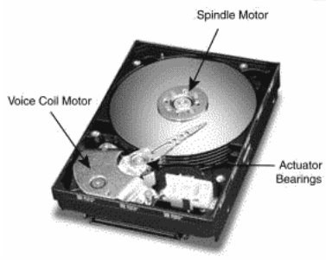
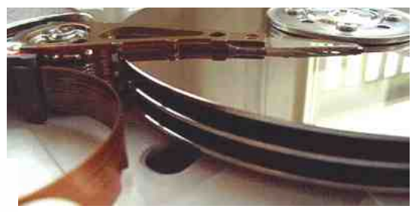
The I/O Bottleneck
Bits read from a disk encounter two potential transfer rate limits:
The rate at which bits spin under the heads on their way to a buffer
The rate at which the I/O channel or I/O bus can transfer the contents

Slide 37
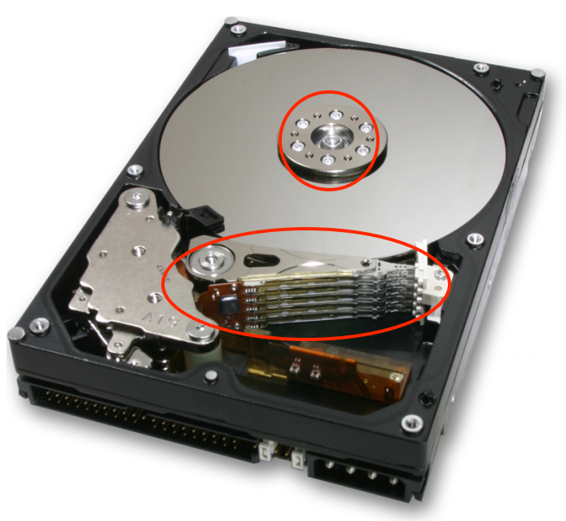
The I/O Bottleneck
Average seek latency: about 8 milliseconds
Time to move the head over 1/3 of the disk
The average rotational latency: 4.17 milliseconds
The disks spin at 7200 rotations/minute
One rotation every 8.33 milliseconds (60/7200)
On average, the disk has to wait a half rotation for the desired block to be under the disk head

Slide 38
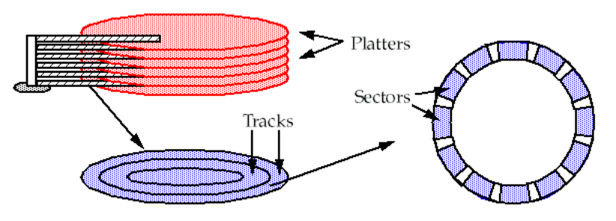
A Typical Modern 400 Gigabyte Disk
Has 16,383 cylinders, or about 24 megabytes per cylinder
Would have 8 two-sided platters and thus 16 read/write heads
Would be 24/16 = 1.5 megabytes per track
When rotating at 7200 revolutions per minute (120 per second)
The bits will go by a head at 180 megabytes per second (1.5 x 120)

Slide 39
Bottleneck
The IDE bus: 66 MB/S is common
The Serial ATA-3 bus: 6 Gbps
With IDE bus: The electronics would be the bottleneck
at 66 MB/S
With SATA-3 bus: The mechanics would be the bottleneck
at 180 MB/S

Slide 40
Latency of 4-KB Data Accessing (Using IDE)
The latency of reading a 4 kilobyte block chosen at random:
avg seek time + avg rotation latency + transmission of 4 kilobytes
= 8 + 4.17 + (4 / (66 × 1024)) × 1000 milliseconds
= 8 + 4.17 + 0.06 milliseconds
= 12.23 milliseconds
The throughput for reading randomly-chosen blocks one by one is:
= 1000/12.23 × 4 kilobytes per second
= 327 kilobytes/second

Slide 41
Round-1: No Optimization
1 in ← OPEN ("in", READ) // open "in" for reading
2 out ← OPEN ("out", WRITE) // open "out" for reading
3
4 while not ENDOFFILE (in) do
5 block ← READ (in, 4096) // read 4 kilobyte block from in
6 block ← COMPUTE (block) // compute for 1 millisecond
7 WRITE (out, block, 4096) // write 4 kilobyte block to out
8 CLOSE (in)
9 CLOSE (out)
reading 4 kilobyte + 1 millisecond of computation + writing 4 kilobyte
= 12.23 + 1+ 12.23 milliseconds
= 25.46 milliseconds

Slide 42
Round-2
Modify the file system
to layout the blocks of a file contiguously
to prefetch an entire track of data on each read
Average seek time + 1 rotational delay
= 8 + 8.33 milliseconds = 16.33 milliseconds

Slide 43
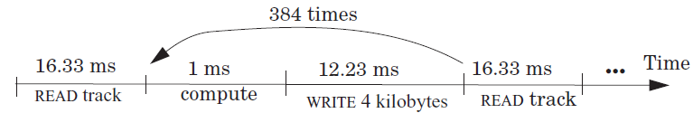
Round-2
File system issues 1 read request per 384 (1.5 MB per track / 4 KB) loop iterations
The average time for 384 iterations is:
reading 1536 kilobyte + 384× (1 millisecond of computation + writing 4 kilobyte)
= 16.33 + 384 × (1 + 12.23) millisecond
= 16.33 + 5080.32 milliseconds
= 5096.65 milliseconds
Thus, the average time for a loop iteration is 5096.65/384 = 13.27 milliseconds

Slide 44
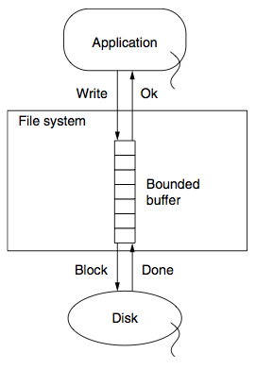
Round-3
Improve by dallying & batching write requests
Write to buffer in RAM and flush when buffer is full
Latency = (16.33 + 384 + 16.33)/384 milliseconds
= 1.09 milliseconds

Slide 45
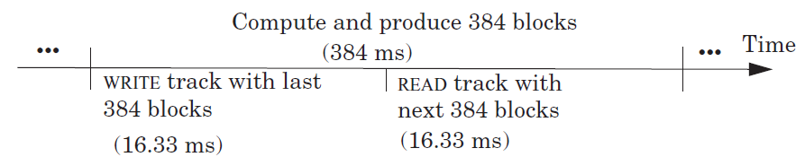
Round-4
Prefetch the next track before the 385th READ
Overlap computation and I/O completely
The average time around the loop is 1 millisecond
The bottleneck now is the CPU

Slide 46
Cache Policies
Multi-level Memory

Slide 47
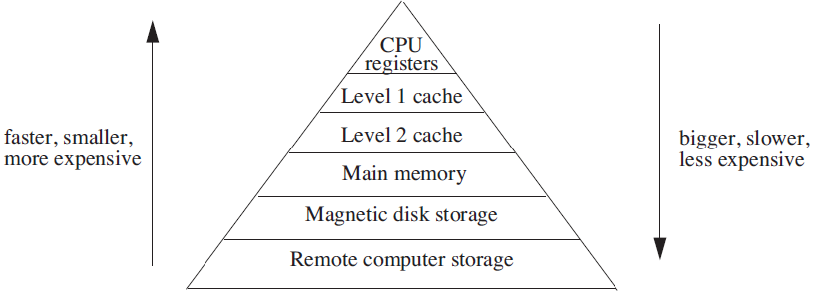
Analyzing Multilevel Memory Systems
Only consider the adjacent pair of levels
View it as a two level multilevel memory system
The 1st is primary device, the 2nd is secondary device

Slide 48
Locality of Reference and Working Sets
In many situations most memory references are to a small set of addresses for significant periods of time
As the application progresses, the area of concentration of access shifts, but its size still typically remains small
Called "locality of reference"
Temporal locality and spatial locality
Thrashing: repeated movement of data back and forth between two levels

Slide 49
Multilevel Memory Management Policies
Each level of multilevel memory system can be characterized by 4 items:
The string of references directed to that level
The bring-in policy for that level
The removal policy for that level
The capacity of the level

Slide 50
Page-removal Policies
First-in, first-out (FIFO) page-removal policy
Remove the page that has been in the primary device the longest
Belady's anomaly
Performance drops with a larger primary device capacity!
Optimal (OPT) page-removal policy
Choose for removal the page that will not be needed for the longest time
Least-recently-used (LRU) page-removal policy
The page in the primary device that has not been used for the longest time

Slide 51
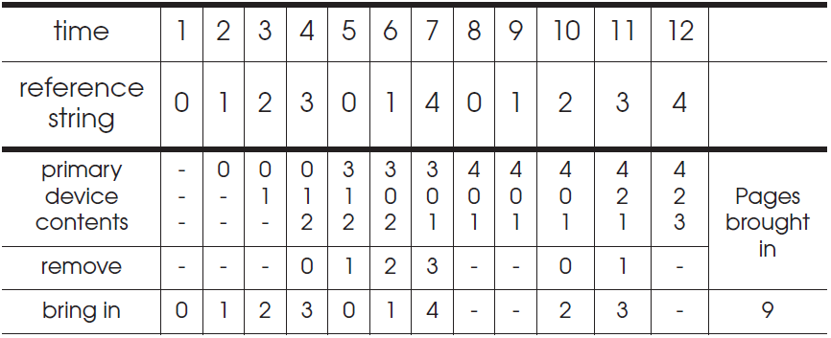
First-in, First-out (FIFO) Page-Removal Policy
The page for removal is the one that has been in the primary device the longest

Slide 52
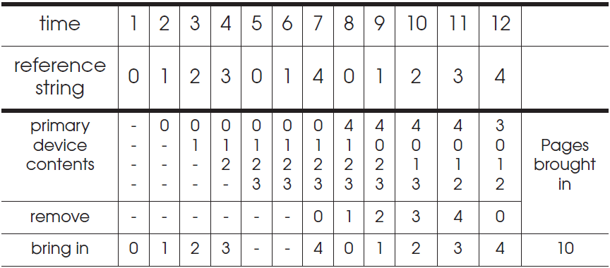
Belady's Anomaly
Increase of missing-page exception numbers with a larger primary device capacity

Slide 53
Stack Algorithms
Subset property
For the optimal policy, at all times, the pages it keeps in the 3-page memory is a subset of that it keeps in the 4-page memory
No Belady's anomaly if subset property holds
At all times and for every possible capacity of primary device, it creates a total ordering for pages at a given time

Slide 54
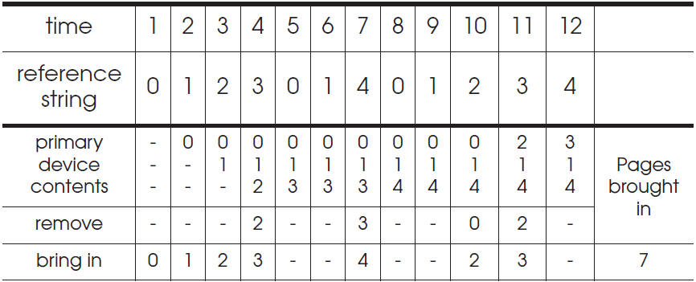
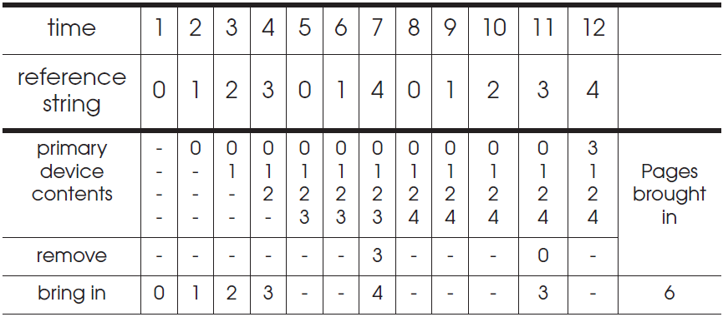
OPT (Optimal) Page-Removal Policy
Always choose for removal the page that will not be needed for the longest time

Slide 55
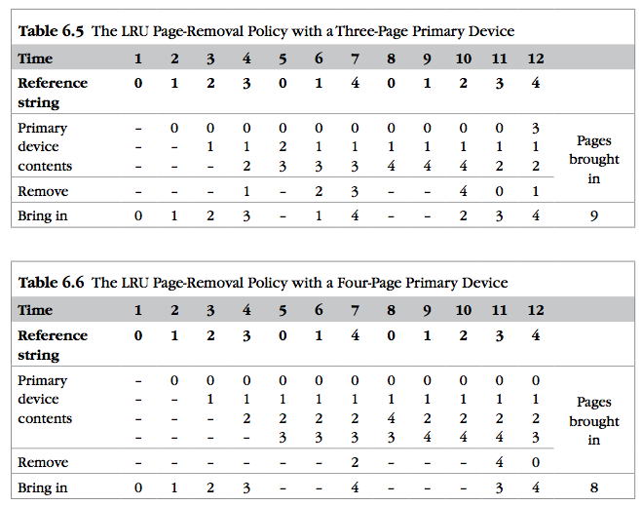
LRU
It is confirmed as an error, in errata part I.
Notes:
It is confirmed as an error, in errata part I.

Slide 56

Least-recently-used (LRU) Page Removal Policy
A program that runs from top to bottom
the virtual memory that is larger than primary device
LRU: always evicts exactly the wrong page
Most-recently-used (MRU) page-removal policy

Slide 57
Comparative Analysis of Different Policies
Ways of deciding the following two things:
How large the primary memory device should be?
Which page removal policy to use?
Collecting traces of the reference strings of typical programs
Simulate the multilevel memory manager with:
Different configurations - Size of primary device
Page removal policy - Traces of memory access

Slide 58
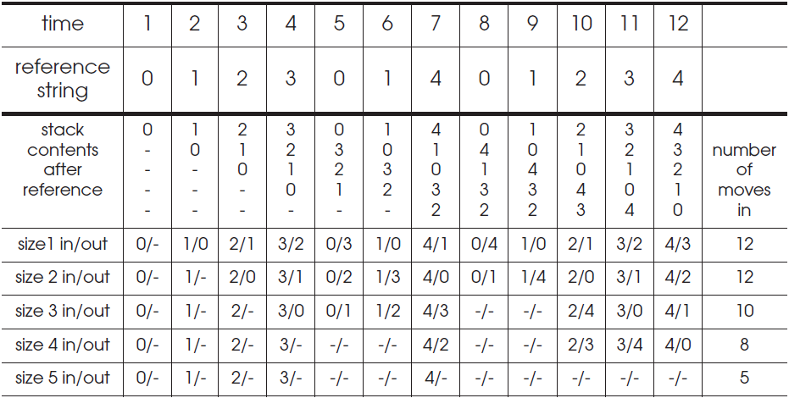
Stack Algorithms for LRU
It can perform a simulation for all possible primary memory size with a single pass through a given reference string

Slide 59
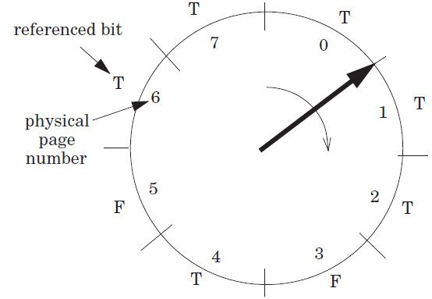
Efficiency of Page-Removal Policies
Clock page-removal algorithm
Base on a hardware setting bit
Reference bit
Move clockwise
If T, set F
Choose as the victim otherwise
Random removal policy
For TLB
Directed mapping

